Slide 1

(L,W)CS182/282A: Designing, Visualizing and Understanding Deep Neural Networks
John Canny
Spring 2020

Slide 2
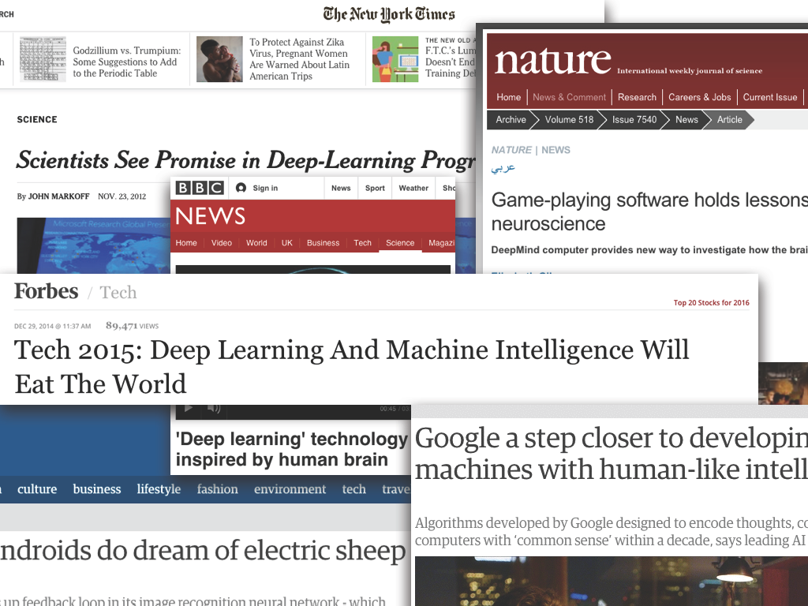

Deep Learning: Hype or Hope?

Slide 3
Deep Learning: Hype or Hope?
Hype: (n) “extravagant or intensive publicity or promotion”
Hope: (n) “expectation of fulfillment or success”

Slide 4
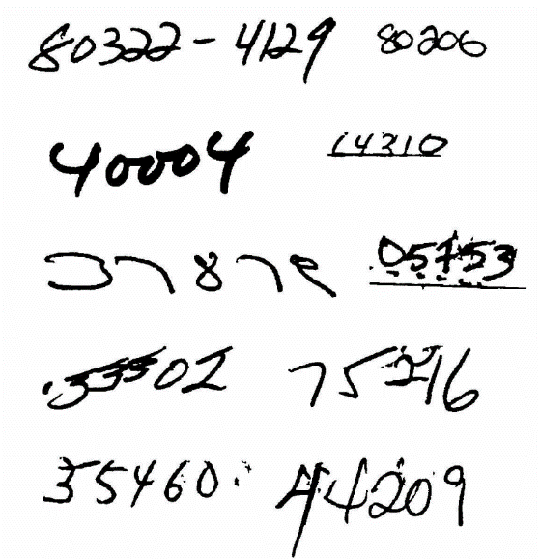
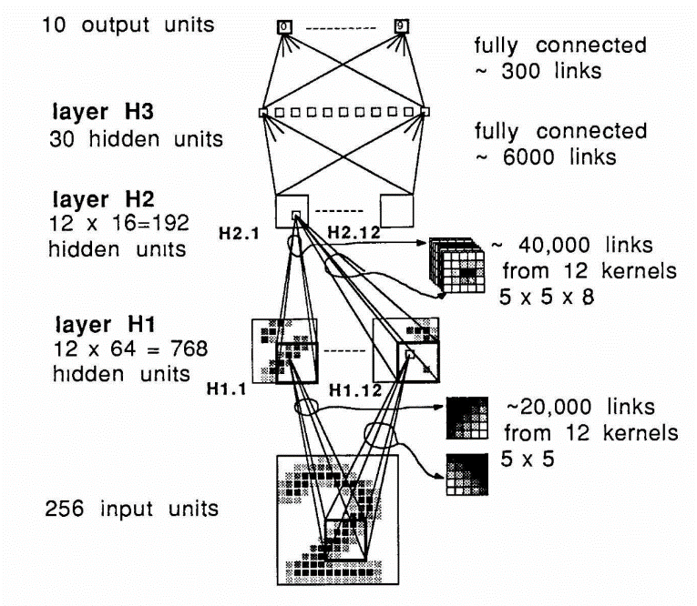
Milestones: Digit Recognition
LeNet 1989: recognize zip codes, Yann Lecun, Bernhard Boser and others, ran live in US postal service
Notes:
Around 5% error rate. Good enough to be useful.

Slide 5
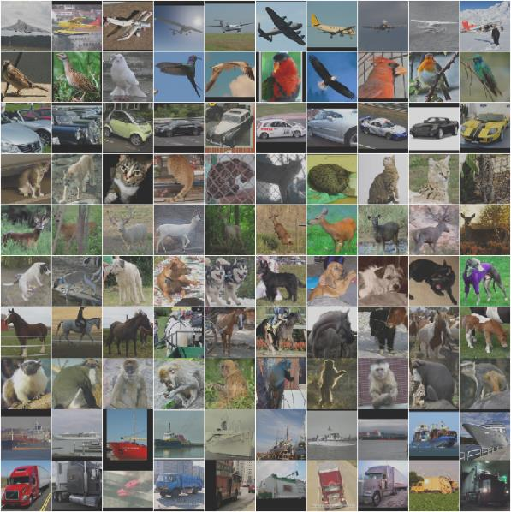
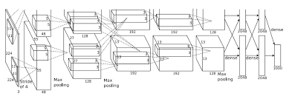
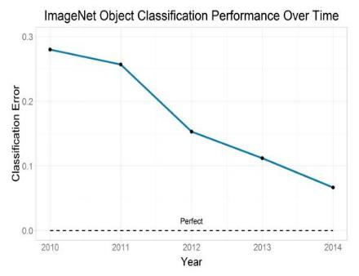
Milestones: Image Classification
Convolutional NNs: AlexNet (2012): trained on 200 GB of ImageNet Data
Almost a LeNet !
Human performance 5.1% error
CNNs
2017

Slide 6
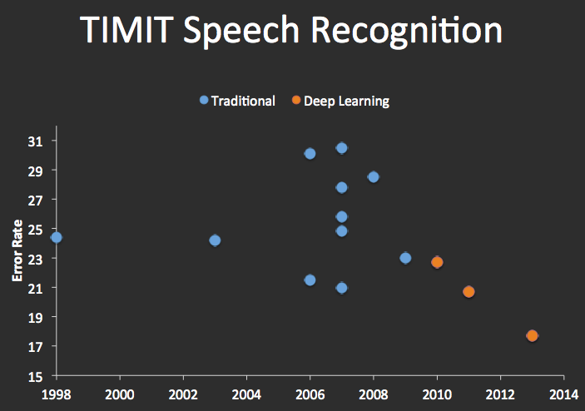
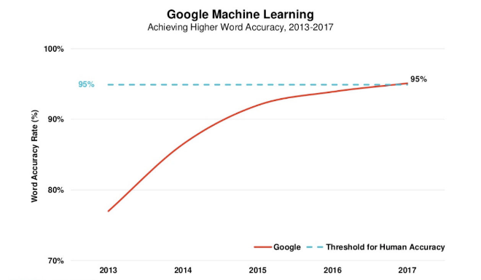
Milestones: Speech Recognition

Slide 7
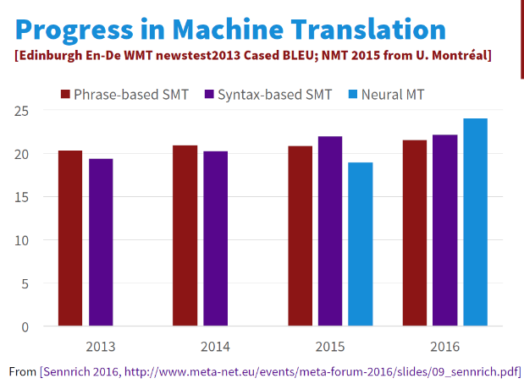
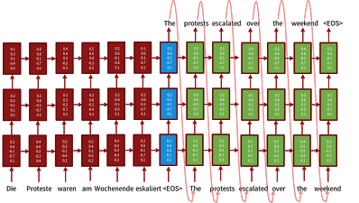
Milestones: Language Translation
Sequence-to-sequence models with recurrent Nets and attention:
Source Luong, Cho, Manning ACL Tutorial 2016.

Slide 8
Neural Text Processing 2017
Notes:
Point: AI progress is not restricted to a small sample of breakthrough problems. Its increasingly the norm.

Slide 9
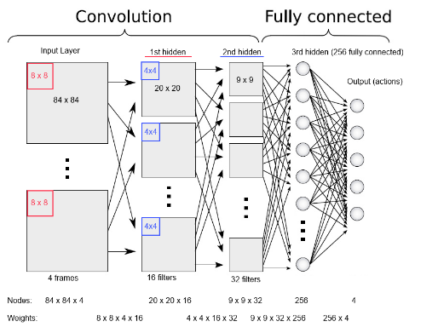
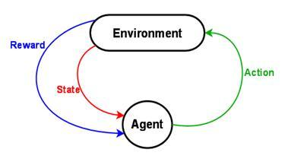
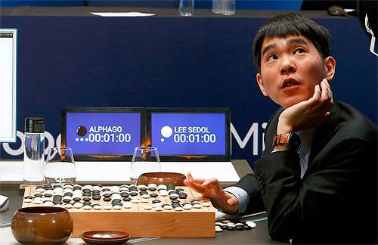
Milestones: Deep Reinforcement Learning
In 2013, Deep Mind’s arcade player bests human expert on six Atari Games. Acquired by Google in 2014,.
In 2016, Deep Mind’s
alphaGo defeats former world champion Lee Sedol
Notes:
Founders: Demis Hassabis, Shane Legg, Mustafa Suleyman
Why was this milestone particularly worrying from an ethics point of view?

Slide 10
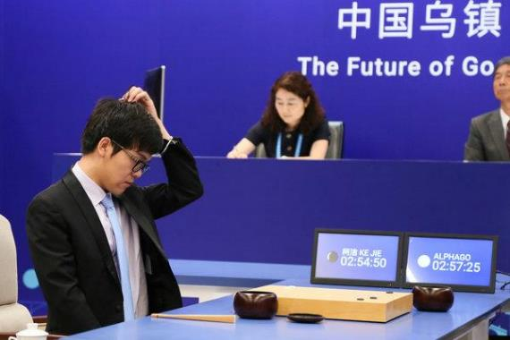
Milestones: Deep Reinforcement Learning
2017: AlphaGo defeats world champion Ke Jie
Commentators noted that Ke appeared to borrow moves from AlphaGo 2016
But Ke noted that “AlphaGo is improving too fast” and is “a different player from last year”
Notes:
Founders: Demis Hassabis, Shane Legg, Mustafa Suleyman
Why was this milestone particularly worrying from an ethics point of view?

Slide 11
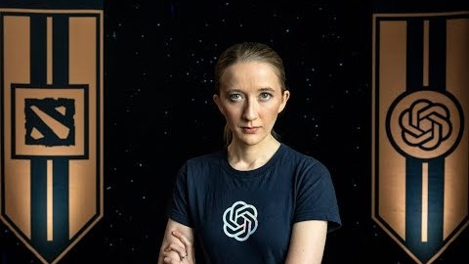
Risks
2018: OpenAI’s Dota agent achieve top 99.95% performance against Human opponents.
AI Risk/Impacts research is very active now, e.g. at DeepMind, and Berkeley’s CHAI project.

Slide 12
Deep Learning: Is it Hype or Hope?

Slide 13
Deep Learning: Is it Hype or Hope?
Yes !

Slide 14
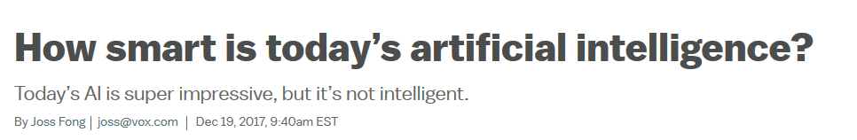
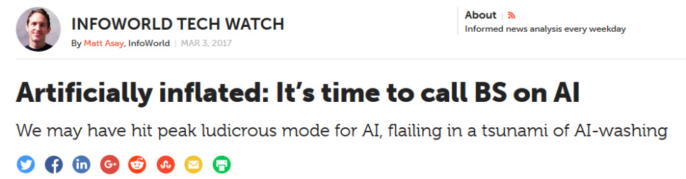
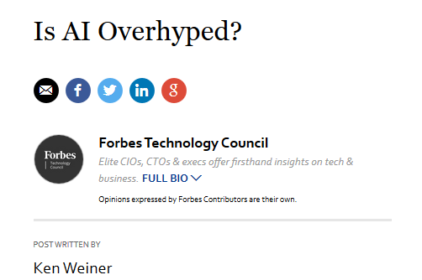
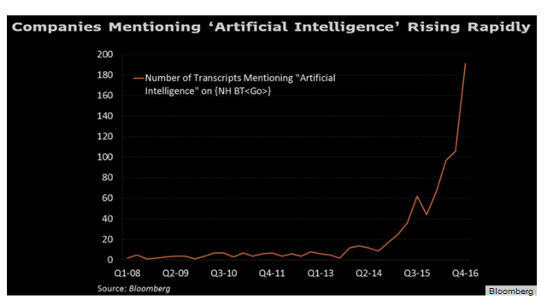
Critiques

Slide 15
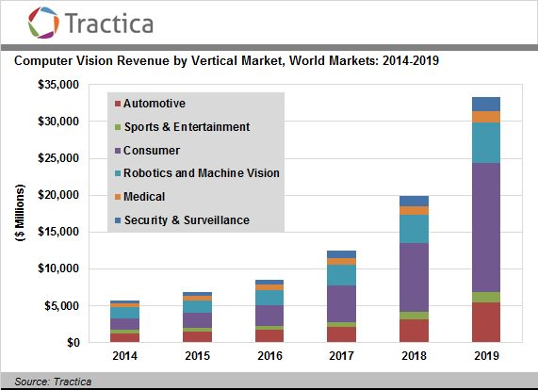
Critiques

Slide 16
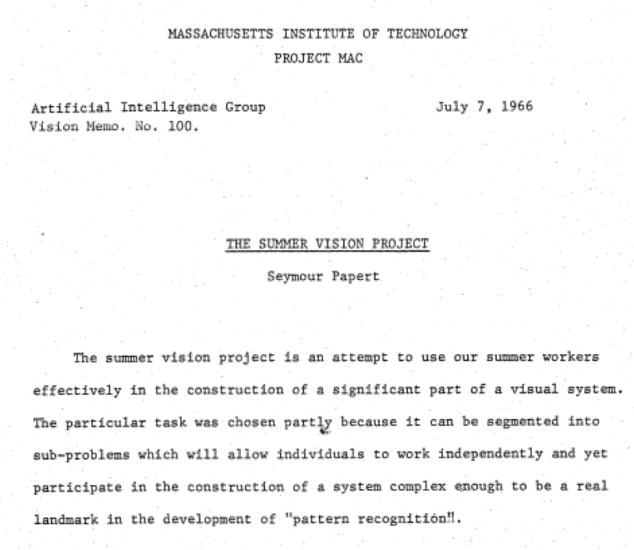
Setting Expectations … Badly
Notes:
Computer vision, a good challenge for a summer project

Slide 17
Critiques:
(Some) AI Scientists made over-optimistic predictions about AI system capabilities in the 80s and 90s leading to an “AI winter.” So optimistic predictions about AI systems today should be ignored…
The assertion relies on faulty logic:
AI systems → intrinsically poor performance
AI researcher → always over-estimate
AI systems are still not “generally intelligent,” … even if they are awfully good at an awful lot of things.
As a concept “general intelligence” has been the bane of AI research.
Progress in AI has recently been dictated mostly by economic importance, not “AI-hardness”. The “AI-hard” list shrinks every year: Jeopardy, Go, Science Exams, Face recognition, Translation,…

Slide 18
Data on Classical AI vs. Deep Learning:
Performance floor
Performance floor
Human performance 5.1% error
CNNs
2017
Where’s the floor ?
Notes:
Doesn’t make sense to make assertions about (Deep) AI systems based on behavior of classical AI systems.

Slide 19
Opportunities:
Of course!
Science, engineering, entertainment, education, communication, organization, recreation, medicine, driving, games (real and virtual), transportation, commerce, e-trading, name-your-topic…
Notes:
Doesn’t make sense to make assertions about (Deep) AI systems based on behavior of classical AI systems.

Slide 20
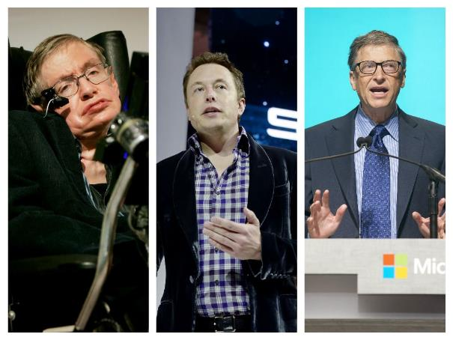
Risks:
Yes!
Economic: displacing jobs
Existential: security, systems running amok
Hawking, Musk, Gates have been highlighting the risks of new AI technologies.

Slide 21
Learning about Deep Neural Networks
Yann Lecun (Facebook research head, DNN pioneer) quote: DNNs require: “an interplay between intuitive insights, theoretical modeling, practical implementations, empirical studies, and scientific analyses”
i.e. there isn’t a single framework or core set of principles to explain everything (c.f. graphical models for machine learning).
We try to cover the ground in Lecun’s quote.

Slide 22
This Course (please interrupt with questions)
Goals:
Introduce deep learning to a broad audience.
Review principles, techniques and visualization for understanding deep networks.
Develop skill at designing networks for applications.
Materials:
Book(s)
Notes
Lectures

Slide 23


The role of Animation
From A. Karpathy’s cs231n notes.

Slide 24
This Course: bCourses page
The course will run through bCourses.
The bCourse Home page is the master link to everything.
The “syllabus” page contains only assignment deadlines, don’t use it for other purposes.

Slide 25
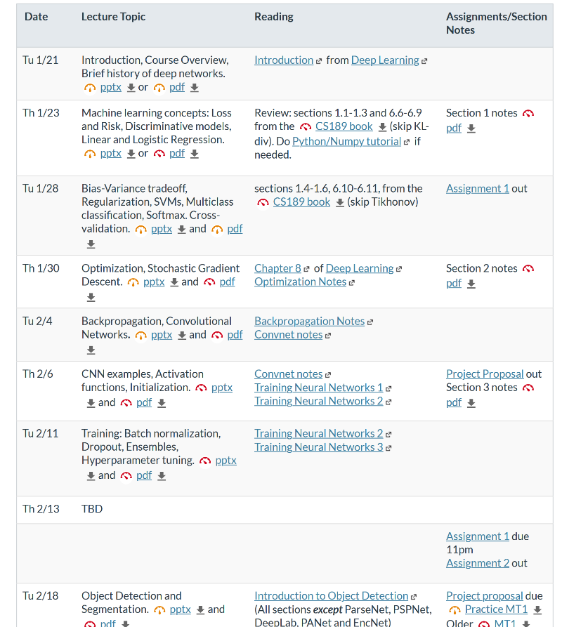
bCourses Home page has the schedule

Slide 26

bCourses Schedule (home page)
Intro., ML review
Computer Vision, General DNN principles
Natural language, Generative and Adversarial Nets
Imitation and reinforcement learning
Notes:
Mention midterms

Slide 27
This Course
Work:
Class Participation: 10%
2 Midterms: 30%
Final Project (in groups): 30%
4 Assignments : 30%
Audience: primarily EECS undergrads and grads.

Slide 28
Discussion Sections
No discussions this week, they start next Week.

Slide 29
Class Format Rationale: L and W sections
Empirically, in previous semesters, we’ve found that students either attend almost all lectures, or almost none.
Standard lecture-format courses waste resources in that situation (huge mostly-empty classrooms).
The experience is mostly-online, but content is optimized for in-class delivery.
Instructor time is dominated with logistics rather than pedagogy.

Slide 30
Class Format Rationale: L and W sections
L sections let us use classroom space efficiently, and encourage interaction.
Content can be optimized for online delivery.
Course manager assumes more of the course logistics, freeing the instructor to focus on content and pedagogy.

Slide 31
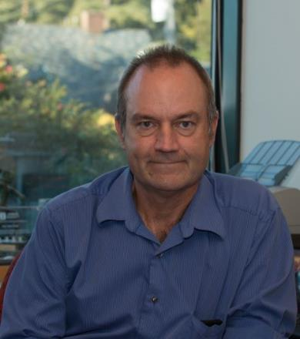
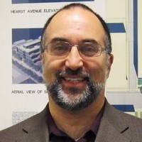






Course Staff
Prof: John Canny Course Manager:
Michael-David Sasson
GSIs:
David Chan
Haozhi Qi
Philippe Laban
Aravind Srinivas
Roshan Rao
Forrest Huang

Slide 32
Prerequisites
Knowledge of calculus and linear algebra, Math 53/54 or equivalent.
Probability and Statistics, CS70 or Stat 134. CS70 is bare minimum preparation, a stat course is better.
Machine Learning: CS189, strongly encouraged but not required.
Programming, CS61B or equivalent. Assignments will mostly use Python.

Slide 33
Logistics
Course Number: CS L182/W182/282A, SP 2020
On bCourses, most material is publicly readable.
Instructor: John Canny lastname@berkeley.edu
Time: TuTh 9:30am – 11:00am
Location: 306 Soda
Discussion: Join Piazza for announcements and to ask questions about the course
Section times, staff office hours are on the main page
Webcasts (video) will appear on our youtube channel.
We will also post augmented powerpoint slides (with audio and Q/A) after lecture.

Slide 34
Logistics
iClickers ?

Slide 35
Course Project
Will consume about 2/3 of the semester.
In teams of 3-4.
Can be combined with other course projects
We encourage “open-source” projects that can be archived.
You will “check-in” with the GSIs several times during the semester.
Final video and report due at the end of the semester.
Difference from last year: CS182 projects will be limited to a set of Kaggle challenges. CS 282A projects will be open-ended.

Slide 36
Questions ?
Coming up: Some rationale for deep neural networks…
Notes:
David Marr, visual models grounded in psycho-physics

Slide 37
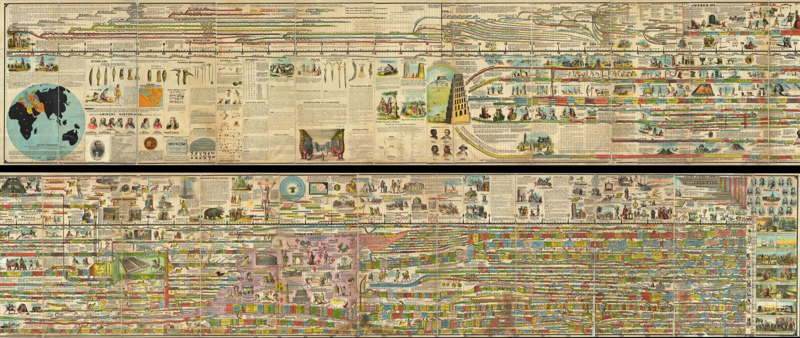
Some History
Reading: the Deep Learning Book, Introduction

Slide 38
Phases of Neural Network Research
1940s-1960s: Cybernetics: Brain like electronic systems, morphed into modern control theory and signal processing.
1960s-1980s: Digital computers, automata theory, computational complexity theory: simple shallow circuits are very limited in what they can represent…
1980s-1990s: Connectionism: complex, non-linear networks, back-propagation.
1990s-2010s: Computational learning theory, graphical models: Learning is computationally hard, simple shallow circuits are very limited in what they can learn…
2006→: Deep learning: End-to-end training, large datasets, explosion in applications.

Slide 39
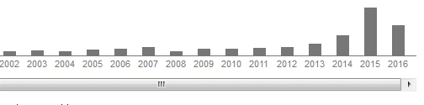
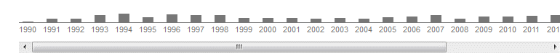
Citations of the “LeNet” paper
Recall the LeNet was a modern visual classification network that recognized digits for zip codes. Its citations look like this:
The 2000s were a golden age for machine learning, and marked the ascent of graphical models. But not so for neural networks.
Second phase
Deep Learning “Winter”
Third phase

Slide 40
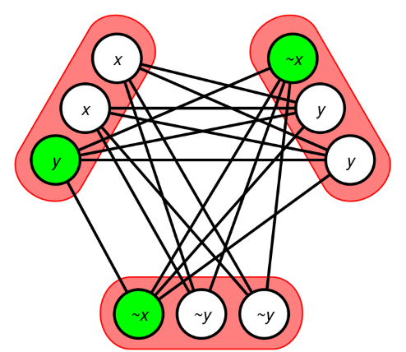
Why the success of DNNs is surprising
From both complexity and learning theory perspectives, simple neural networks are very limited.
Can’t compute parity with a small network.
NP-Hard to learn “simple” functions like 3SAT formulae, and i.e. training a DNN is NP-hard.

Slide 41
Why the success of DNNs is surprising
The most successful DNN training algorithm is a version of gradient descent which will only find local optima. In other words, it’s a greedy algorithm.
Greedy algorithms are even more limited in what they can represent and how well they learn.
If a problem has a greedy solution, its regarded as an “easy” problem.

Slide 42
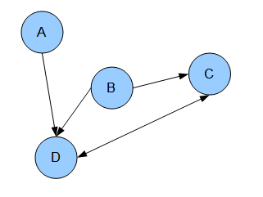
Why the success of DNNs is surprising
In graphical models, values in a network represent random variables, and have a clear meaning. The network structure encodes dependency information, i.e. you can represent rich models.
In a DNN, node activations encode nothing in particular, and the network structure only encodes (trivially) how they derive from each other.

Slide 43
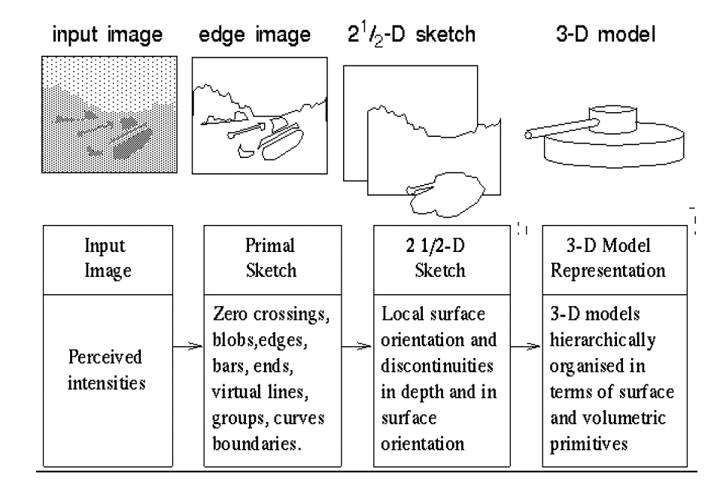
Why the success of DNNs is surprising obvious
Hierarchical representations are ubiquitous in AI. Computer vision:
Stages of Visual Representation, David Marr, 1970s

Slide 44
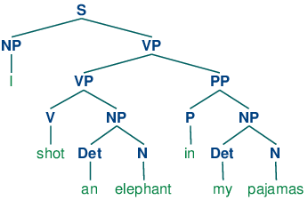
Why the success of DNNs is surprising obvious
Hierarchies are ubiquitous in natural language:

Slide 45
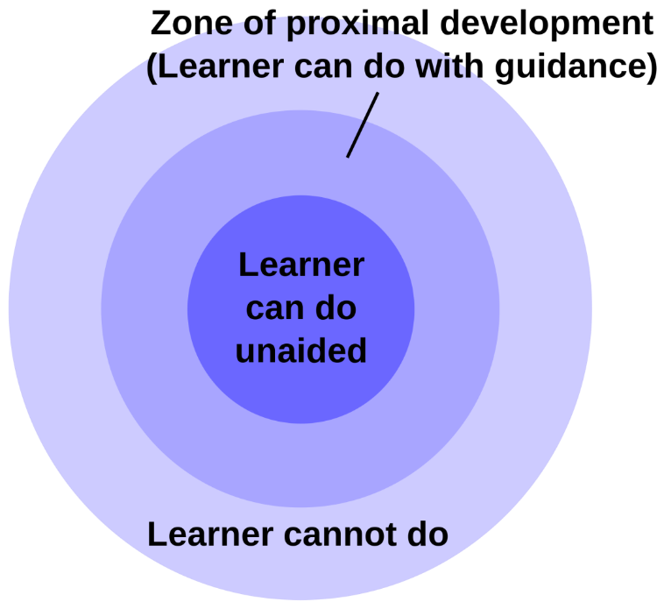
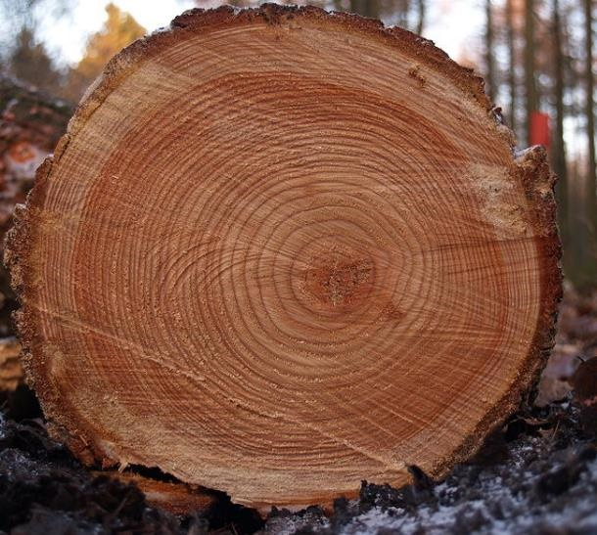
Why the success of DNNs is surprising obvious
Human Learning: is deeply layered.
Deep expertise

Slide 46
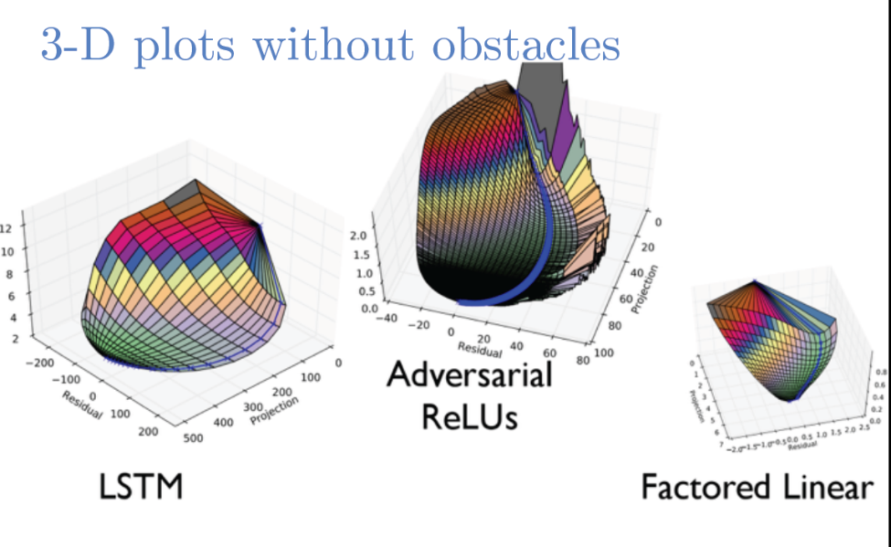
Why the success of DNNs is surprising obvious
What about greedy optimization?
Less obvious, but it looks like many learning problems (e.g. image classification) are actually “easy” i.e. have reliable steepest descent paths to a good model.
Ian Goodfellow – ICLR 2015 Tutorial

Slide 47
Questions ?
Coming up: Representation Learning
Notes:
David Marr, visual models grounded in psycho-physics

Slide 48
Hierarchical Representations
Hierarchical representations are ubiquitous in AI, but had to be hand-designed. In computer vision again:
Stages of Visual Representation, David Marr, 1970s

Slide 49
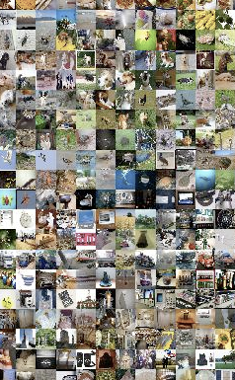
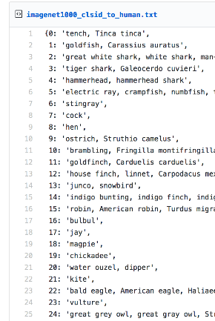
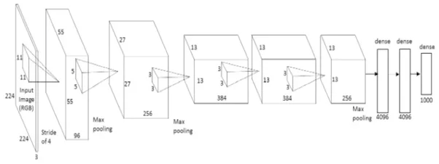
Representation Learning
Learning Layered Representations: Training a deep Imagenet classifier:
“Alexnet” (Krizhevsky) from 2012
1000 labels
1.4 million images

Slide 50
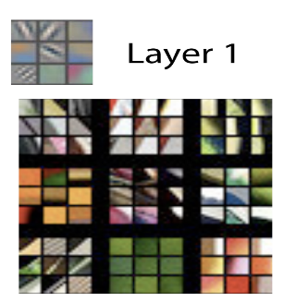
Representation Learning
After a lot of training…
Zeiler and Fergus, “Visualizing and Understanding Convolutional Networks”, 2013
Neural receptive field gray is zero black is negative white is positive
Image patches with strongest responses
Notes:
Explain: each patch shows the patch of the input that the neuron responds to.
The color shows how that neuron responds to that patch:
gray: no change
Black: output decreases
White: output increases

Slide 51
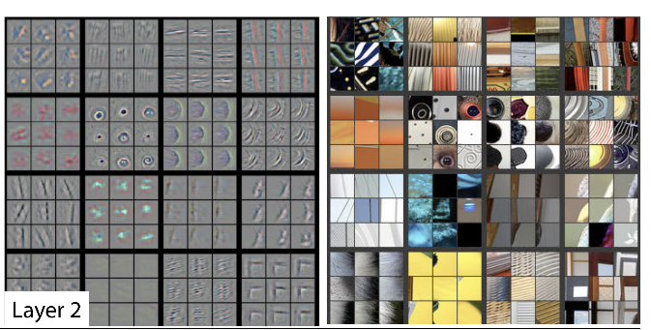
Representation Learning
Neural receptive fields gray is zero black is negative white is positive
Image patches with strongest responses
Zeiler and Fergus, “Visualizing and Understanding Convolutional Networks”, 2013

Slide 52
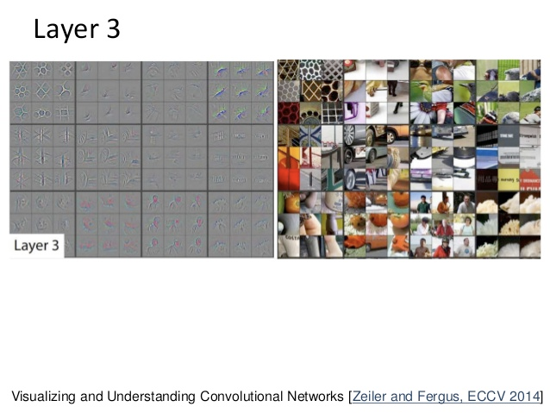
Representation Learning
Neural receptive fields
Image patches with strongest responses
Zeiler and Fergus, “Visualizing and Understanding Convolutional Networks”, 2013

Slide 53
Representation Learning
Interpretable
patches
Zeiler and Fergus, “Visualizing and Understanding Convolutional Networks”, 2013

Slide 54
Representation Learning
Not so much…
Zeiler and Fergus, “Visualizing and Understanding Convolutional Networks”, 2013

Slide 55
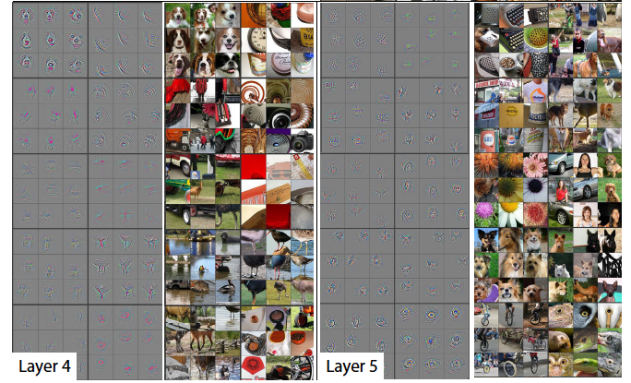
Representation Learning
Zeiler and Fergus, “Visualizing and Understanding Convolutional Networks”, 2013

Slide 56
Representation Learning
These inner representations were learned only from input image/output labels.
Early and intermediate layer weights are typically task-independent.
1000 labels
1.4 million images
Notes:
Deep nets learn to solve general problems in order to solve specific ones…

Slide 57
Consequences
You can reuse or customize models trained for different task.
Image Classification

Slide 58
Reuse/Fine Tuning
You can reuse or customize models trained for different task, with much less data.
Image Captioning
Freeze or slow weight training
Notes:
Many, probably most users of DL models don’t train them from scratch. They use pretrained models.

Slide 59
Multi-task Learning
Sharing model weight across tasks often improves performance on both.
Image Classification
Image Captioning

Slide 60
Summary of Deep Net Properties
Layered architecture (the deep part) of simple units.
Inner layer representations are learned only from end-to-end tasks.
Depth and complexity seem to be only limited by the amount of data. More complex models → better representations → better accuracy.
This behavior is fundamentally different from classical ML: there is often no obvious performance ceiling.
Inner layer representations are typically task-independent → easy to re-use models for applications that don’t have large training datasets.
Multi-task learning usually works: another departure from typical behavior of classical ML methods.

